Slide 1
Lec00-Software Develop 2024 Spring Introduction
ispace.xjtu.edu.cn
Professor Li,Bo(李波)
boblee@xjtu.edu.cn,13709218618
School of Computer Science and Technology
Xi’an Jiaotong University

Slide 2
Conferences by SigSoft
ASE
Automated Software Engineering Conference: held every 12 months, in September in even-numbered years, in November in odd-numbered years.
DEBS
International Conference on Distributed and Event-based Systems: held every 12 months, typically in June.
ESEC/FSE
Joint European Software Engineering Conference and Symposium on the Foundations of Software Engineering: held annually. Formerly alternating between ESEC/FSE every other year, alternating with FSE. A list of past ESEC/FSE conferences is below.
ESEM
International Symposium on Empirical Software Engineering and Management: held every 12 months, typically in the fall.
ICPE
International Conference on Performance Engineering: held every 12 months, typically in April.
ICSE
International Conference on Software Engineering: held every 12 months, typically in May. ICSE Conferences' history page lists past events.
ISSTA
International Symposium on Software Testing & Analysis: held every 12 months, typically in July or August.
MOBILESoft
International Conference on Mobile Software Engineering and Systems: held every 12 months, collocated with ICSE.
MoDELS
International Conference on Model-Driven Engineering Languages and Systems: held every 12 months, typically in October.

Slide 3
Retrospective Awards
Awarded in 2012 | Walter F. Tichy. Design, Implementation, and Evaluation of a Revision Control System. In ICSE '82: Proceedings of the 6th International Conference on Software Engineering, 1982 Debra J. Richardson, Stephanie Leif Aha and T. Owen O'Malley. Specification-based Test Oracles for Reactive Systems. In ICSE '92: Proceedings of the 14th International Conference on Software Engineering, 1992 P. Borras, D. Clement, Th. Despeyroux, J. Incerpi, G. Kahn, B. Lang, and V. Pascual. Centaur: the System. In PSDE 3: Proceedings of the 3rd ACM SIGSOFT/SIGPLAN Symposium on Practical Software Development Environments, 1989 J. Magee and J. Kramer. Dynamic Structure in Software Architectures. In FSE 4: Proceedings of the 4th ACM SIGSOFT Symposium on Foundations of Software Engineering, 1996 A.M. Zaremski and J. Wing. Specification Matching of Software Components. In FSE 3: Proceedings of the 3rd ACM SIGSOFT Symposium on Foundations of Software Engineering, 1995
Awarded in 2011 | Dewayne E. Perry and Alexander L. Wolf. Foundations for the Study of Software Architecture. In ACM SIGSOFT Software Engineering Notes, vol. 17, no. 4, October 1992. Thomas Reps, Susan Horowitz, Mooly Sagiv and Genevieve Rosay. Speeding Up Slicing. In Proc. Second ACM SIGSOFT Symposium on Foundations of Software Engineering, New Orleans, LA, USA, December 1994. David Garlan, Robert Allen and John Ockerbloom. Architectural Mismatch or Why It's Hard to Build Systems Out of Existing Parts. In Proc. 17th International Conference on Software Engineering, Seattle, WA, USA, April 1995. Gail C. Murphy, David Notkin and Kevin Sullivan. Software Reflexion Models: Bridging the Gap between Source and High-Level Models. In Proc. Third ACM SIGSOFT Symposium on Foundations of Software Engineering, Washington, DC, USA, October 1995.
Awarded in 2010 | Thomas Reps and Tim Teitelbaum. The Synthesizer Generator. In SDE 1, Proceedings of the first ACM SIGSOFT/SIGPLAN Software Engineering Symposium on Practical Software Development Environments, 1984. Karl J. Ottenstein and Linda M. Ottenstein. The Program Dependence Graph in a Software Development Environment. In SDE 1, Proceedings of the first ACM SIGSOFT/SIGPLAN Software Engineering Symposium on Practical Software Development Environments, 1984. Robert Balzer. Tolerating Inconsistency. In ICSE '91, Proceedings of the 13th International Conference on Software Engineering. David Lorge Parnas. Software Aging. In ICSE '94, Proceedings of the 16th International Conference on Software Engineering.

Slide 4
Retrospective Awards
Awarded in 2009 | T.J. McCabe, A Complexity Measure. IEEE Transactions on Software Engineering, vol. 2, no. 4, pp. 308-320, July 1976. Rapps, S. and Weyuker, E. J. Data flow analysis techniques for test data selection. In Proceedings of the 6th international Conference on Software Engineering (Tokyo, Japan, September 13 - 16, 1982). International Conference on Software Engineering. IEEE Computer Society Press, Los Alamitos, CA, 272-278. Reiss, S.P., PECAN: Program Development Systems that Support Multiple Views. IEEE Transactions on Software Engineering, vol.SE-11, no.3, pp. 276-285. March 1985. Barry W. Boehm, A Spiral Model of Software Development and Enhancement. Computer, vol. 21, no. 5, pp. 61-72, May 1988. Royce, W. W. Managing the development of large software systems: concepts and techniques. In Proceedings of the 9th international Conference on Software Engineering (Monterey, California, United States). International Conference on Software Engineering. IEEE Computer Society Press, Los Alamitos, CA, 328-338.
Awarded in 2008 | Harel, D., Lachover, H., Naamad, A., Pnueli, A., Politi, M., Sherman, R., and Shtul-Trauring, a. STATEMATE: a working environment for the development of complex reactive systems. In Proceedings of the 10th International Conference on Software Engineering (Singapore, April 11 - 15, 1988). International Conference on Software Engineering. IEEE Computer Society Press, Los Alamitos, CA, 396-406. Ungar, D. Generation Scavenging: A non-disruptive high performance storage reclamation algorithm. SIGPLAN Not. 19, 5 -- ACM SIGSOFT/SIGPLAN software engineering symposium on Practical software development environments, (May. 1984), 157-167. Parnas, D. L., Clements, P. C., and Weiss, D. M. The modular structure of complex systems. In Proceedings of the 7th International Conference on Software Engineering (Orlando, Florida, United States, March 26 - 29, 1984). International Conference on Software Engineering. IEEE Press, Piscataway, NJ, 408-417. Weiser, M. Program slicing. In Proceedings of the 5th International Conference on Software Engineering (San Diego, California, United States, March 09 - 12, 1981). International Conference on Software Engineering. IEEE Press, Piscataway, NJ, 439-449. Liskov, B., Snyder, A., Atkinson, R., and Schaffert, C. Abstraction mechanisms in CLU. In Proceedings of An ACM Conference on Language Design For Reliable Software (Raleigh, North Carolina, March 28 - 30, 1977). D. B. Wortman, Ed., 140.

Slide 5
ACM SIGSOFT Impact Paper Award
2021 | Matthew B. Dwyer, George S. Avrunin, and James C. Corbett. Patterns of Property Specifications for Finite-State Verification. In Proceedings of the 21st Internation Conference on Software Engineering (ICSE 1999, Los Angeles, California, May 1999). "For enabling widespread use of temporal logic for program verification by raising the level of abstraction to common patterns."
2020 | Willem Visser, Klaus Havelund, Guillaume Brat, SeungJoon Park. Model Checking Programs. In Proceedings of the 15th IEEE International Conference on Automated Software Engineering (ASE 2000, Grenoble, France, 11-15 Sep 2000).
2019 | Koushik Sen, Darko Marinov and Gul Agha. CUTE: A Concolic Unit Testing Engine for C. In Proceedings of the 10th European Software Engineering Conference held jointly with 13th ACM SIGSOFT international symposium on Foundations of Software Engineering (ESEC/FSE-13, Lisbon, Portugal, 5-9 Sep 2005).
2018 | Lingxiao Jiang, Ghassan Misherghi, Zhendong Su, and Stephane Glondu. DECKARD: Scalable and Accurate Tree-Based Detection of Code Clones. In Proceedings of the 29th Internation Conference on Software Engineering (ICSE '07, Minneapolis, Minnesota, 20-26 May 2007).
2017 | Roy T. Fielding and Richard N. Taylor. Principled Design of the Modern Web Architecture. In Proceedings of the 22nd Internation Conference on Software Engineering (ICSE '00, Limerick, Ireland, 5-7 June, 2000).
2016 | Daniel Jackson and Mandana Vaziri. Finding bugs with a constraint solver. In Proceedings of the 2000 ACM SIGSOFT International Symposium on Software Testing and Analysis (ISSTA '00, Portland, Oregon, 22-24 August, 2000).
2015 | James A. Jones, Mary Jean Harrold, and John Stasko. Visualization of Test Information to Assist Fault Localization. In ICSE '02: Proceedings of the 24th International Conference on Software Engineering (Orlando, Florida, 19-24 May, 2002).
2014 | Barbara Kitchenham, Tore Dybå, and Magne Jørgensen. Evidence-Based Software Engineering. In ICSE '04: Proceedings of the 26th International Conference on Software Engineering (Edinburgh, Scotland, 23-28 May, 2004).

Slide 6
ACM SIGSOFT Impact Paper Award
2013 | Michael Ernst, Jake Cockrell, Bill Griswold, and David Notkin. Dynamically Discovering Likely Program Invariants to Support Program Evolution. In ICSE '99: Proceedings of the 21st International Conference on Software Engineering (Los Angeles, California, 16-22 May, 1999).
2012 | Chandrasekhar Boyapati, Sarfraz Khurshid, and Darko Marinov. Korat: Automated Testing Based on Java Predicates. In Proceedings of the 2002 ACM SIGSOFT International Symposium on Software Testing and Analysis (Roma, Italy, 22 - 24 July, 2002).
2011 | Luca de Alfaro and Thomas A. Henzinger. Interface automata. In Proceedings of ESEC/FSE-9, the joint 8th European Software Engineering Conference and 9th ACM SIGSOFT International Symposium on the Foundations of Software Engineering (Vienna, Austria, 10 - 14 September, 2001).
2010 | James C. Corbett, Matthew B. Dwyer, John Hatcliff, Shawn Laubach, Corina S. Pasareanu, Robby, Hongjun Zheng. Bandera: extracting finite-state models from Java source code. In Proceedings of the 22nd International Conference on Software Engineering, 2000.
2009 | Andreas Zeller. Yesterday, my program worked. Today, it does not. Why?. In Proceedings of the 7th European Software Engineering Conference Held Jointly with the 7th ACM SIGSOFT international Symposium on Foundations of Software Engineering (Toulouse, France, 6 - 10 September, 1999). Foundations of Software Engineering. Springer-Verlag, London, 253-267. (Listen to Andreas' Impact Award keynote.)
2008 | Rosenblum, D. S. and Wolf, A. L. A design framework for Internet-scale event observation and notification. In Proceedings of the 6th European SOFTWARE ENGINEERING Conference Held Jointly with the 5th ACM SIGSOFT international Symposium on Foundations of Software Engineering (Zurich, Switzerland, 22 - 25 September, 1997). M. Jazayeri and H. Schauer, Eds. Foundations of Software Engineering. Springer-Verlag New York, New York, NY, 344-360.

Slide 7
Grading System
Object-oriented Analysis and Design using UML-40%
Exam in class(40% )
Design Pattern Reading Report-15%
Each Student pickup a topic by himself, writes a paper
one is a formal paper ,another is a presentation (PPT)
I will give you a topic list
Evaluating by meeting-sharing your knowledge
Being as coach-15%
A lecture，solution reference，executive（audit） report
Agile software development（scrum）
Unit testing
Version Control
Project-30%
A Lecture，Project report（3 members in a group）
Programming for the iPhone and Project
Programming for the Android and Project
Notes:
30人分成10组
Design pattern 4个小时（报告 8个）
Scrum 2个小时（4个报告）
Unit test 2个小时（4个报告）
Version control 2个小时（4个报告）
项目开题报告2小时（10个报告）
项目解题报告2小时（10个报告）

Slide 8
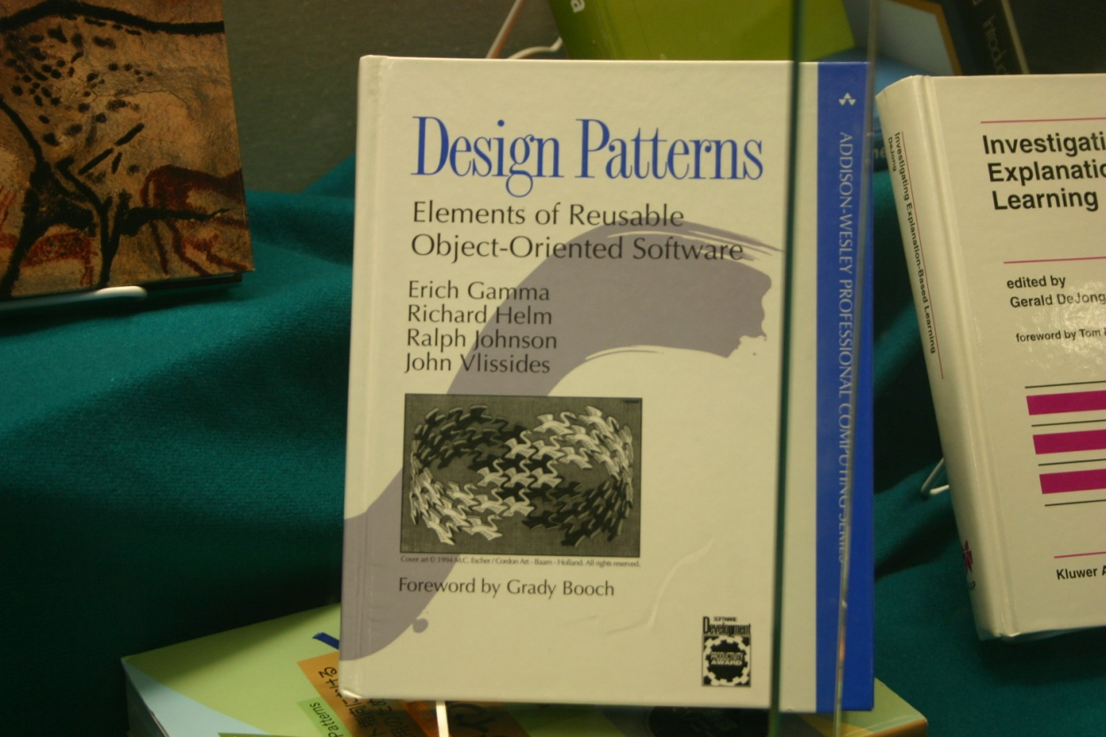
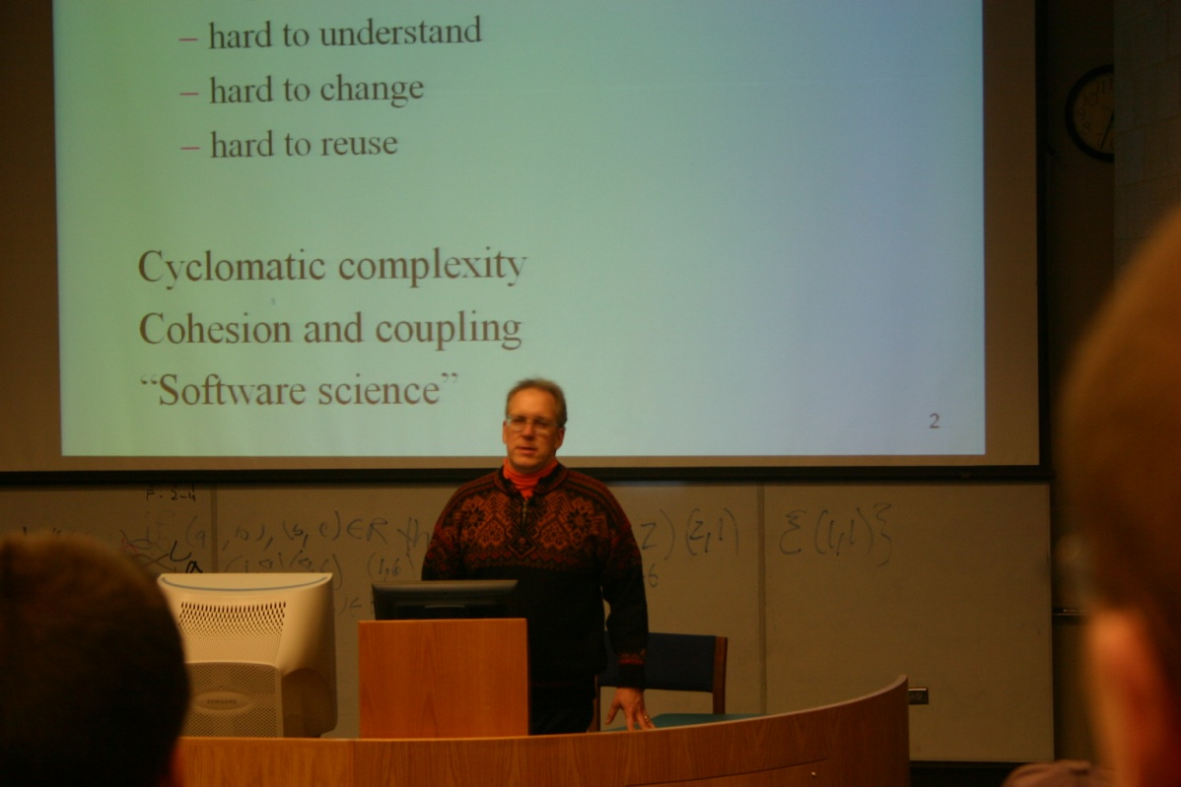
Gang of Four
Design Patterns
Elements of Reusable Object-Oriented Software
Gamma, Helm, Johnson & Vlissides, 1995

Slide 9
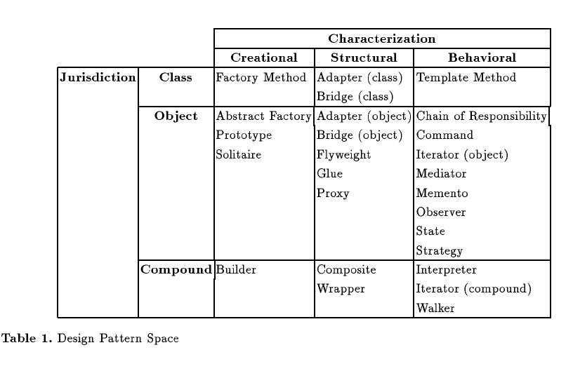
Topic List

Slide 10
Suggested books
Beginning iOS 4 Application Development (Amazon)
Head First iPhone Development (Amazon)
Head First Design Patterns (Amazon)
SCRUM
The official ScrumGuide by K. Schwaber and J. Sutherland
An IEEE paper on SCRUM for small teams
SCRUM and XP from the Trenches: A very good practitioners view of SCRUM by H. Kniberg

Slide 11

iPhone Development
You first need to register as an iPhone developer to access most of these links. There is a wealth of information in the iOS Dev Center. I highly recommend starting with the material under Resources for iOS 4.2, including:
Getting started documents
iOS Reference Library
Coding How-Tos
Sample Code
Other assorted list of useful documentation:
A Primer for learning Objective-C.
There is also a much longer introduction to Objective-C.
Properties are interesting way of defining accessor methods. Be sure to check the link.
Introduction to first iPhone application

Slide 12
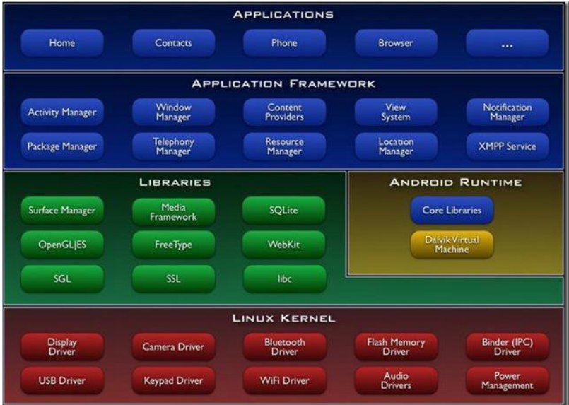
Android Platform

Slide 13
Schedule
Meeting1
Introduction to the Course
Programming (Machine Problem) and Reading Topic
Brief Introduction of Software development(lec0-82) and Software Engineering(lec1-108)
Meeting2
Best Practices of Software Engineering-01BestPractices.ppt(57)
Introduction to Rational Unified Process-02RUP.ppt(39)
Meeting3
Introduction to Object Orientation-03Introtooo.ppt(64)
Meeting4
Requirements Overview-04reqover.ppt(37)
Meeting5
Analysis and Design Overview-05adover.ppt(13)
Architectural Analysis-06archanalysis.ppt(36)

Slide 14
Meeting6
Use-Case Analysis-07ucanylysis.ppt(79)
Meeting7
Architectural Design-08archdesign.ppt(68)
Meeting8
Describe Concurrency-09descrcon.ppt(28)
Describe Distributeion-10decrdis.ppt(28)
Meeting9
Use-Case Design-11ucdesign.ppt(38)
Meeting10
Subsystem Design-12ssdesign.ppt(32)
Meeting11
Class Design-13classdesign.ppt(131)
Meeting12
Exam

Slide 15
SE education :Cloud and Mobile

Slide 16
CS169: Software Engineering, University of California, Berkeley Armando Fox & David Patterson
What is covered in the course?
Introduction to SaaS and software lifecycles: Waterfall, Spiral, RUP, Agile
Project Management: Pair programming and Scrum vs. Planning and Project manager
Requirements Elicitation: User Stories vs. Contracts
Testing: Behavior Driven Design and Test Driven Development vs. Code then test
Maintenance: Legacy, Refactoring, and Agile
Version control systems and releases
Design patterns
Performance, reliability, and security
http://www.saasbook.info/instructors

Slide 17
What is the format of the course?
One semester (14 weeks), 3 hours of lecture per week, and 1 hour of TA-led discussion per week.
How are students assessed? multiple means.
Seven programming assignments, which are autograded
Two midterm exams
Semester long team project for external non-technical customer done in 4 iterations. Customers give feedback with each iteration, and a TA grades each iteration.
Final poster session, including demonstrating the application to the customer.
This course is the basis of two massive open online courses (MOOCs) from UC Berkeley and EdX: CS169.1X covers the first six weeks of the Berkeley course, and CS169.2X covers the next six weeks.

Slide 18
Course textbooks and materials
Engineering Software as a Service: An Agile Approach Using Cloud Computing,
by Armando Fox and David Patterson, Strawberry Canyon Publisher, 2013.
Why do you teach the course this way?
The full answer is in the Communications of the ACM article “Viewpoint: Crossing the Software Education Chasm,” May 2012, pp. 17-22.

Slide 19
Whatʼs the problem?!
New dev hires good at coding, debugging* !
New hires are NOT good at:!
testing!
working in teams!
communicating with customers!
dealing with legacy software!
Complaint: SWE courses teach outdated methodologies, avoid these real problems!
Constraint: Undergrad spends ~12 hr./week per course = 3 work-weeks during semester!
*Sources: Google, eBay, Amazon, Microsoft, Facebook, & Begel et al. 2008 study!

Slide 20
Approach: SW Eng. With SaaS!
Teach SaaS & cloud computing using Rails!
– High productivity!
– Great testing tools, ease of public deployment!
•Emphasizes testing at all levels!
– 2 of 16 projects: 100% unit test (statement)coverage, 100ʼs integration tests!
Small-team, Agile development !
– Projects varied in amount of functionality—not code quality!
– Agile is great fit for classroom!

Slide 21
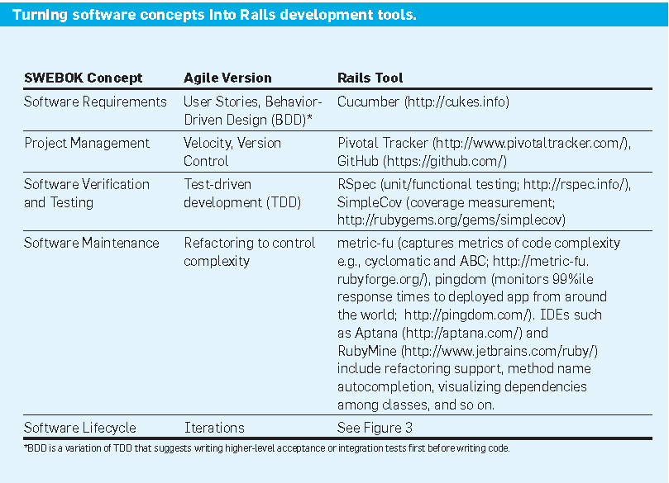
Notes:
Velocity is calculated by estimating units of work per user story and then counting how many units are completed.

Slide 22
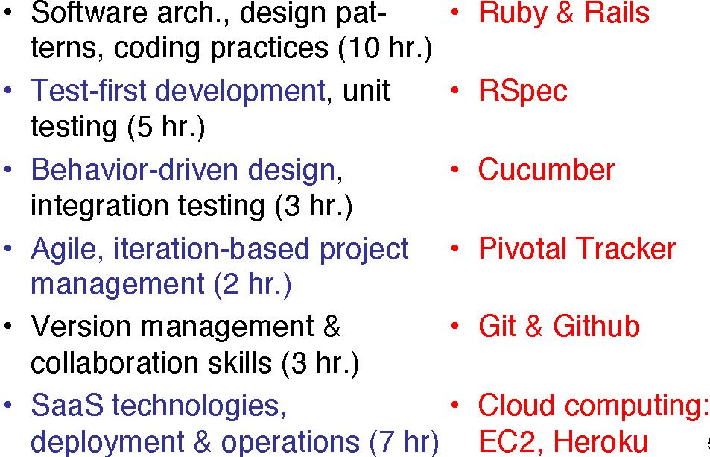
Learn by doing

Slide 23
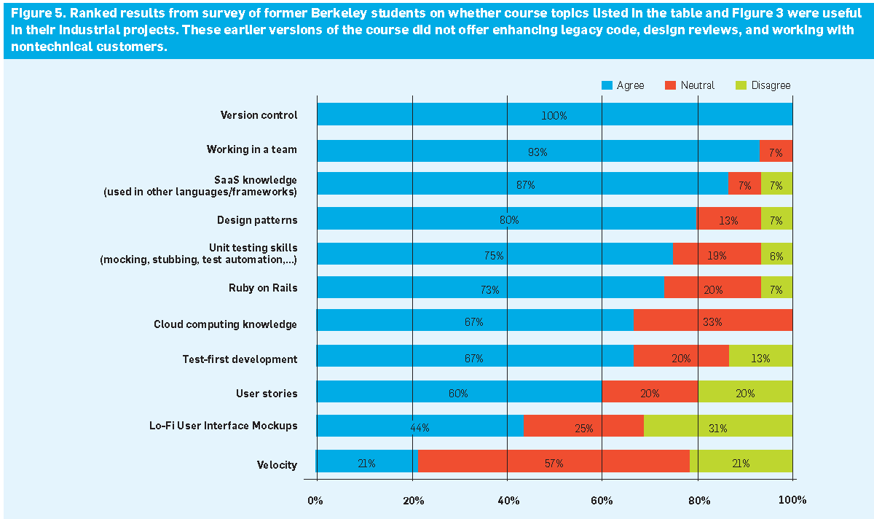

Slide 24
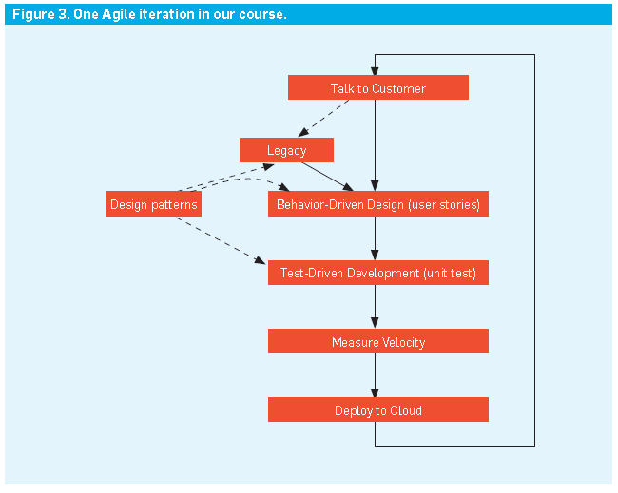

Slide 25
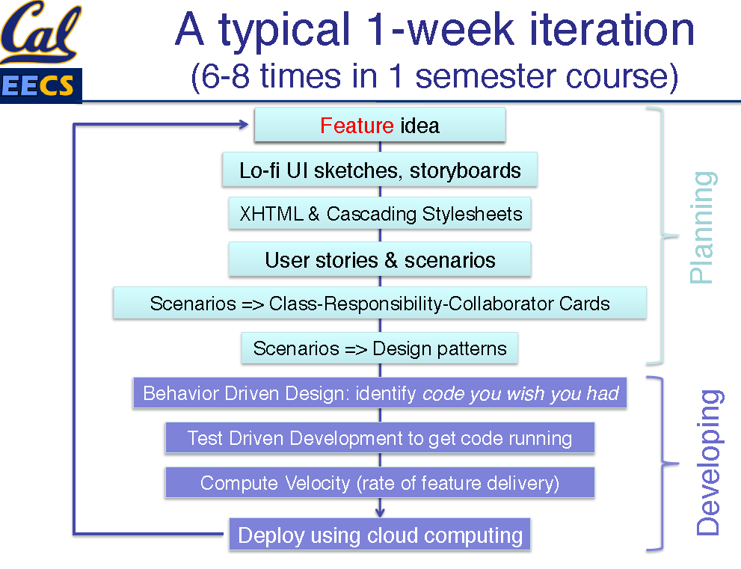
Notes:
从低保真度(lo-fi)到高保真度(hi-fi)

Slide 26
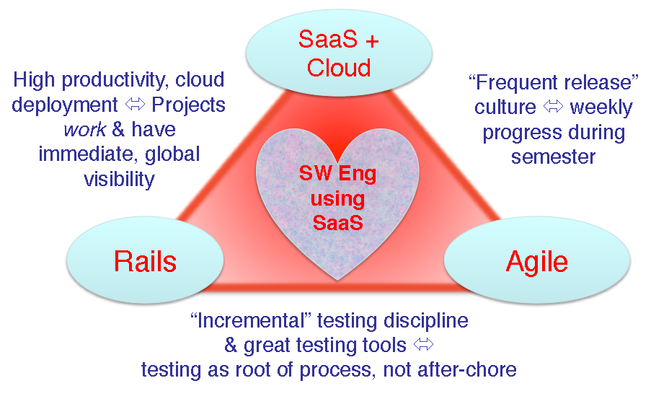
SaaS Love Triangle
Notes:
从低保真度(lo-fi)到高保真度(hi-fi)
after chore
家务琐事之后

Slide 27
Mobile
Mobile Apps for the Greater Good: A Socially Relevant Approach to Software Engineering
V. Paul Pauca
Department of Computer Science
Wake Forest Univeirsity

Slide 28
Thanks

